Slide 1
Computer Networks
Java Basics-I
Lab 09
Demonstrator Kabeer Ahmed
MCS and MS Telecommunication & Network

Slide 2
Lecture Objectives
Learn about Java basics.
Know the usage of Java programming language.
Designing and running Java programs.

Slide 3
JDK
Sort of software development kit that allows to create software applications.
NETBEANS/JBUILDER is Integrated development environment.

Slide 4
Introduction to Java Applications
Outline
2.1 Introduction
2.2 A First Program in Java: Printing a Line of Text
2.3 Modifying Our First Java Program
2.4 Displaying Text in a Dialog Box
2.5 Another Java Application: Adding Integers
2.7 Arithmetic

Slide 5
2.1 Introduction
In this chapter
  Introduce examples to illustrate features of Java
  Two program styles - applications and applets

Slide 6
How to run program
Create a batch file which contains the following line:
  set PATH=C:\Program Files\Java\jdk1.6.0\bin;
Now you have set the path. You can use the statements javac and java.
javac statement compiles the code into byte code and generates the .class file.
java statement executes the code.

Slide 7
2.2 A First Program in Java: Printing a Line of Text
Application
  Program that executes using the java interpreter
Sample program
  Show program, then analyze each line

Slide 8
Welcome1.java
Program Output
Welcome to Java Programming!
1 // Fig. 2.1: Welcome1.java
2 // Text-printing program.
3
4 public class Welcome1 {
5
6 // main method begins execution of Java application
7 public static void main( String args[] )
8 {
9 System.out.println( "Welcome to Java Programming!" );
10
11 } // end method main
12
13 } // end class Welcome1

Slide 9
2.2 A Simple Program: Printing a Line of Text
  Name of class called identifier
    Series of characters consisting of letters, digits,
    underscores ( _ ) and dollar signs ( $ )
    Does not begin with a digit, has no spaces
    Examples: Welcome1, $value, _value, button7
      7button is invalid
    Java is case sensitive (capitalization matters)
      a1 and A1 are different
4 public class Welcome1 {

Slide 10
2.2 A Simple Program: Printing a Line of Text
    Exactly one method must be called main
  Methods can perform tasks and return information
    void means main returns no information
    For now, mimic main's first line
  Left brace begins body of method declaration
    Ended by right brace } (line 11)
7 public static void main( String args[] )
8 {

Slide 11
2.2 A Simple Program: Printing a Line of Text
  Instructs computer to perform an action
    Prints string of characters
      String - series characters inside double quotes
    White-spaces in strings are not ignored by compiler
  System.out
    Standard output object
    Print to command window (i.e., MS-DOS prompt)
  Method System.out.println
    Displays line of text
    Argument inside parenthesis
  This line known as a statement
    Statements must end with semicolon ;
9 System.out.println( "Welcome to Java Programming!" );

Slide 12
2.2 A Simple Program: Printing a Line of Text
Compiling a program
  Open a command prompt window, go to directory where program is stored
  Type javac Welcome1.java
  If no errors, Welcome1.class created
    Has bytecodes that represent application
    Bytecodes passed to Java interpreter

Slide 13
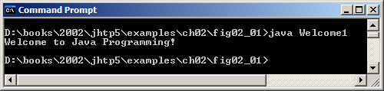
2.2 A Simple Program: Printing a Line of Text
Executing a program
  Type java Welcome1
    Interpreter loads .class file for class Welcome1
    .class extension omitted from command
  Interpreter calls method main
Fig. 2.2 Executing Welcome1 in a Microsoft Windows 2000 Command Prompt.

Slide 14
2.3 Modifying Our First Java Program
Modify example in Fig. 2.1 to print same contents using different code

Slide 15
2.3 Modifying Our First Java Program
Modifying programs
  Welcome2.java (Fig. 2.3) produces same output as Welcome1.java (Fig. 2.1)
  Using different code
9 System.out.print( "Welcome to " );
10 System.out.println( "Java Programming!" );

Slide 16
1 // Fig. 2.3: Welcome2.java
2 // Printing a line of text with multiple statements.
3
4 public class Welcome2 {
5
6 // main method begins execution of Java application
7 public static void main( String args[] )
8 {
9 System.out.print( "Welcome to " );
10 System.out.println( "Java Programming!" );
11
12 } // end method main
13
14 } // end class Welcome2
System.out.print keeps the cursor on the same line, so System.out.println continues on the same line.
Welcome to Java Programming!

Slide 17
1 // Fig. 2.4: Welcome3.java
2 // Printing multiple lines of text with a single statement.
3
4 public class Welcome3 {
5
6 // main method begins execution of Java application
7 public static void main( String args[] )
8 {
9 System.out.println( "Welcome\nto\nJava\nProgramming!" );
10
11 } // end method main
12
13 } // end class Welcome3
Welcome
to
Java
Programming!

Slide 18
2.3 Modifying Our First Java Program
Escape characters
  Backslash ( \ )
  Indicates special characters be output
Escape
Description
sequence
\
n
Newline. Position the screen cursor at the beginning of the
next line.
\
t
Horizontal tab. Move the screen cursor to the next tab stop.
\
r
Carriage return. Position the screen cursor at the beginning of
the current line; do
not advance to the next line. Any
characters output after the carriage return overwrite the
characters previously output on that line.
\
\
Backslash. Used to print a backslash character.
\
"
Double quote. Used to print a double
-
quote character. For
exampl
e,
System.out.println(
"
\
"in quotes
\
""
);
displays
"in quotes"
Fig. 2.5
Some common escape sequences.

Slide 19
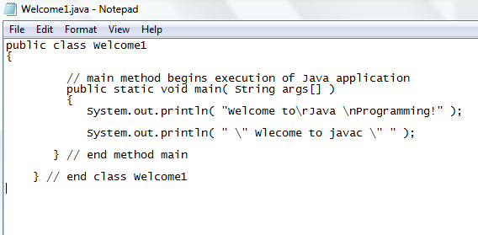

Slide 20
2.4 Displaying Text in a Dialog Box
Display
  Most Java applications use windows or a dialog box
    We have used command window
  Class JOptionPane allows us to use dialog boxes
Packages
  Set of predefined classes for us to use
  Groups of related classes called packages
  JOptionPane is in the javax.swing package
    Package has classes for using Graphical User Interfaces (GUIs)

Slide 21
2.4 Displaying Text in a Dialog Box
Upcoming program
  Application that uses dialog boxes

Slide 22
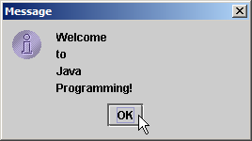
1 // Fig. 2.6: Welcome4.java
2 // Printing multiple lines in a dialog box.
3
4 // Java packages
5 import javax.swing.JOptionPane; // program uses JOptionPane
6
7 public class Welcome4 {
8
9 // main method begins execution of Java application
10 public static void main( String args[] )
11 {
12 JOptionPane.showMessageDialog(
13 null, "Welcome\nto\nJava\nProgramming!" );
14
15 System.exit( 0 ); // terminate application with window
16
17 } // end method main
18
19 } // end class Welcome4

Slide 23
2.4 Displaying Text in a Dialog Box
  Lines 1-2: comments as before
  Two groups of packages in Java API
  Core packages
    Begin with java
    Included with Java 2 Software Development Kit
  Extension packages
    Begin with javax
    New Java packages
  import declarations
    Used by compiler to identify and locate classes used in Java programs
    Tells compiler to load class JOptionPane from javax.swing package
4 // Java packages
5 import javax.swing.JOptionPane; // program uses OptionPane

Slide 24
2.4 Displaying Text in a Dialog Box
  Lines 6-11: Blank line, begin class Welcome4 and main
  Call method showMessageDialog of class JOptionPane
    Requires two arguments
    Multiple arguments separated by commas (,)
    For now, first argument always null
    Second argument is string to display
12 JOptionPane.showMessageDialog(
13 null, "Welcome\nto\nJava\nProgramming!" );

Slide 25
2.4 Displaying Text in a Dialog Box
  All statements end with ;
    A single statement can span multiple lines
    Cannot split statement in middle of identifier or string
  Executing lines 12 and 13 displays the dialog box
    Automatically includes an OK button
      Hides or dismisses dialog box
    Title bar has string Message

Slide 26
2.4 Displaying Text in a Dialog Box
  Calls static method exit of class System
    Terminates application
      Use with any application displaying a GUI
    Because method is static, needs class name and dot (.)
    Identifiers starting with capital letters usually class names
  Argument of 0 means application ended successfully
    Non-zero usually means an error occurred
  Class System part of package java.lang
    No import declaration needed
    java.lang automatically imported in every Java program
  Lines 17-19: Braces to end Welcome4 and main
15 System.exit( 0 ); // terminate application with window

Slide 27
2.5 Another Java Application: Adding Integers
Upcoming program
  Use input dialogs to input two values from user
  Use message dialog to display sum of the two values

Slide 28
1 // Fig. 2.9: Addition.java
2 // Addition program that displays the sum of two numbers.
3
4 // Java packages
5 import javax.swing.JOptionPane; // program uses JOptionPane
6
7 public class Addition {
8
9 // main method begins execution of Java application
10 public static void main( String args[] )
11 {
12 String firstNumber; // first string entered by user
13 String secondNumber; // second string entered by user
14
15 int number1; // first number to add
16 int number2; // second number to add
17 int sum; // sum of number1 and number2
18
19 // read in first number from user as a String
20 firstNumber = JOptionPane.showInputDialog( "Enter first integer" );
21
22 // read in second number from user as a String
23 secondNumber =
24 JOptionPane.showInputDialog( "Enter second integer" );
25
26 // convert numbers from type String to type int
27 number1 = Integer.parseInt( firstNumber );
28 number2 = Integer.parseInt( secondNumber );
29
30 // add numbers
31 sum = number1 + number2;
32
Declare variables: name and type.
Input first integer as a String, assign to firstNumber.
Convert strings to integers.
Add, place result in sum.

Slide 29
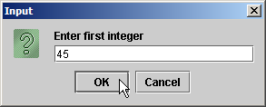
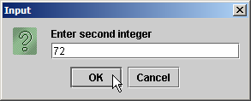
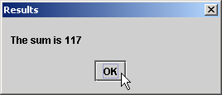
Program output
33 // display result
34 JOptionPane.showMessageDialog( null, "The sum is " + sum,
35 "Results", JOptionPane.PLAIN_MESSAGE );
36
37 System.exit( 0 ); // terminate application with window
38
39 } // end method main
40
41 } // end class Addition

Slide 30
2.5 Another Java Application: Adding Integers
  Location of JOptionPane for use in the program
  Begins public class Addition
    Recall that file name must be Addition.java
  Lines 10-11: main
  Declaration
    firstNumber and secondNumber are variables
5 import javax.swing.JOptionPane; // program uses JOptionPane
7 public class Addition {
12 String firstNumber; // first string entered by user
13 String secondNumber; // second string entered by user

Slide 31
2.5 Another Java Application: Adding Integers
  Variables
    Location in memory that stores a value
      Declare with name and type before use
    firstNumber and secondNumber are of type String (package java.lang)
      Hold strings
    Variable name: any valid identifier
    Declarations end with semicolons ;
      Can declare multiple variables of the same type at a time
      Use comma separated list
  Can add comments to describe purpose of variables
12 String firstNumber; // first string entered by user
13 String secondNumber; // second string entered by user
String firstNumber, secondNumber;

Slide 32
2.5 Another Java Application: Adding Integers
  Declares variables number1, number2, and sum of type int
    int holds integer values (whole numbers): i.e., 0, -4, 97
    Types float and double can hold decimal numbers
    Type char can hold a single character: i.e., x, $, \n, 7
15 int number1; // first number to add
16 int number2; // second number to add
17 int sum; // sum of number1 and number2

Slide 33
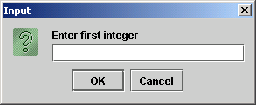
2.5 Another Java Application: Adding Integers
  Reads String from the user, representing the first number to be added
    Method JOptionPane.showInputDialog displays the following:
    Message called a prompt - directs user to perform an action
    Argument appears as prompt text
    If wrong type of data entered (non-integer) or click Cancel, error occurs
20 firstNumber = JOptionPane.showInputDialog( "Enter first integer" );

Slide 34
2.5 Another Java Application: Adding Integers
  Result of call to showInputDialog given to firstNumber using assignment operator.
20 firstNumber = JOptionPane.showInputDialog( "Enter first integer" );

Slide 35
2.5 Another Java Application: Adding Integers
  Similar to previous statement
    Assigns variable secondNumber to second integer input
  Method Integer.parseInt
    Converts String argument into an integer (type int)
      Class Integer in java.lang
    Integer returned by Integer.parseInt is assigned to variable number1 (line 27)
      Remember that number1 was declared as type int
    Line 28 similar
23 secondNumber =
24 JOptionPane.showInputDialog( "Enter second integer" );
27 number1 = Integer.parseInt( firstNumber );
28 number2 = Integer.parseInt( secondNumber );

Slide 36
2.5 Another Java Application: Adding Integers
  Assignment statement
    Calculates sum of number1 and number2 (right hand side)
    Uses assignment operator = to assign result to variable sum
    Read as: sum gets the value of number1 + number2
    number1 and number2 are operands
31 sum = number1 + number2;

Slide 37
2.5 Another Java Application: Adding Integers
  Use showMessageDialog to display results
  "The sum is " + sum
    Uses the operator + to "add" the string literal "The sum is" and sum
    Concatenation of a String and another type
      Results in a new string
    If sum contains 117, then "The sum is " + sum results in the new string "The sum is 117"
    Note the space in "The sum is "
    More on strings in Chapter 11
34 JOptionPane.showMessageDialog( null, "The sum is " + sum,
35 "Results", JOptionPane.PLAIN_MESSAGE );

Slide 38
2.5 Another Java Application: Adding Integers
  Different version of showMessageDialog
    Requires four arguments (instead of two as before)
    First argument: null for now
    Second: string to display
    Third: string in title bar
    Fourth: type of message dialog with icon
      Line 35 no icon: JOptionPane.PLAIN_MESSAGE
34 JOptionPane.showMessageDialog( null, "The sum is " + sum,
35 "Results", JOptionPane.PLAIN_MESSAGE );

Slide 39
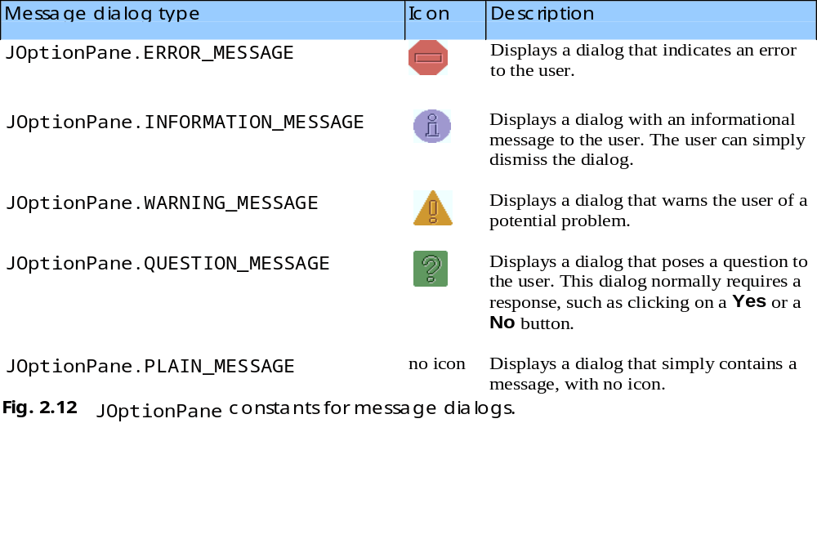
2.5 Another Java Application: Adding Integers

Slide 40
2.7 Arithmetic
Arithmetic calculations used in most programs
  Usage
    * for multiplication
    / for division
    +, -
    No operator for exponentiation (more in Chapter 5)
  Integer division truncates remainder
    7 / 5 evaluates to 1
  Remainder operator % returns the remainder
    7 % 5 evaluates to 2

Slide 41
2.7 Arithmetic
Operator precedence
  Some arithmetic operators act before others (i.e., multiplication before addition)
    Use parenthesis when needed
  Example: Find the average of three variables a, b and c
    Do not use: a + b + c / 3
    Use: ( a + b + c ) / 3
  Follows PEMDAS
    Parentheses, Exponents, Multiplication, Division, Addition, Subtraction

Slide 42
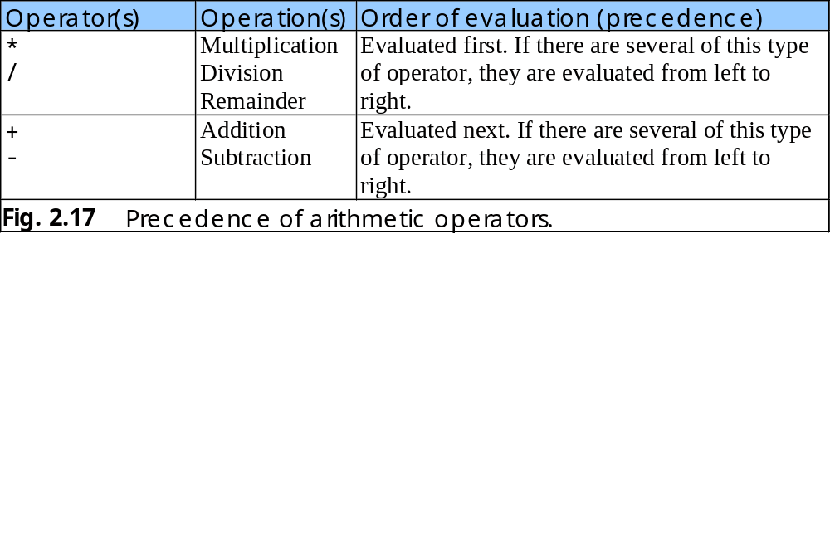
2.7 Arithmetic

Slide 43
2.8 Decision Making: Equality and Relational Operators
if control statement
  Simple version in this section
  If a condition is true, then the body of the if statement executed
  Control always resumes after the if structure
    0 interpreted as false, non-zero is true
  Conditions for if statements can be formed using equality or relational operators (next slide)
  if ( condition )
  statement executed if condition true
    No semicolon needed after condition
      Else conditional task not performed

Slide 44
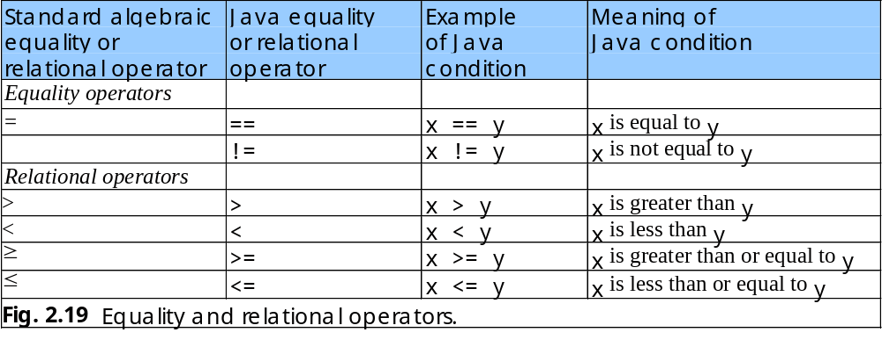
2.8 Decision Making: Equality and Relational Operators

Slide 45
1 // Fig. 2.20: Comparison.java
2 // Compare integers using if statements, relational operators
3 // and equality operators.
4
5 // Java packages
6 import javax.swing.JOptionPane;
7
8 public class Comparison {
9
10 // main method begins execution of Java application
11 public static void main( String args[] )
12 {
13 String firstNumber; // first string entered by user
14 String secondNumber; // second string entered by user
15 String result; // a string containing the output
16
17 int number1; // first number to compare
18 int number2; // second number to compare
19
20 // read first number from user as a string
21 firstNumber = JOptionPane.showInputDialog( "Enter first integer:" );
22
23 // read second number from user as a string
24 secondNumber =
25 JOptionPane.showInputDialog( "Enter second integer:" );
26
27 // convert numbers from type String to type int
28 number1 = Integer.parseInt( firstNumber );
29 number2 = Integer.parseInt( secondNumber );
30
31 // initialize result to empty String
32 result = "";
33

Slide 46
34 if ( number1 == number2 )
35 result = result + number1 + " == " + number2;
36
37 if ( number1 != number2 )
38 result = result + number1 + " != " + number2;
39
40 if ( number1 < number2 )
41 result = result + "\n" + number1 + " < " + number2;
42
43 if ( number1 > number2 )
44 result = result + "\n" + number1 + " > " + number2;
45
46 if ( number1 <= number2 )
47 result = result + "\n" + number1 + " <= " + number2;
48
49 if ( number1 >= number2 )
50 result = result + "\n" + number1 + " >= " + number2;
51
52 // Display results
53 JOptionPane.showMessageDialog( null, result, "Comparison Results",
54 JOptionPane.INFORMATION_MESSAGE );
55
56 System.exit( 0 ); // terminate application
57
58 } // end method main
59
60 } // end class Comparison
Test for equality, create new string, assign to result.
Notice use of JOptionPane.INFORMATION_MESSAGE

Slide 47
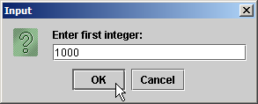
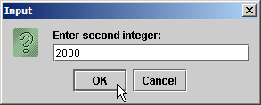
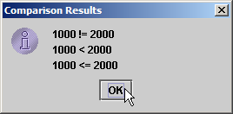
Program Output

Slide 48
2.8 Decision Making: Equality and Relational Operators
  Lines 1-12: Comments, import JOptionPane, begin class Comparison and main
  Lines 13-18: declare variables
    Can use comma-separated lists instead:
  Lines 21-30: obtain user-input numbers and parses input string into integer variables
13 String firstNumber,
14 secondNumber,
15 result;

Slide 49
2.8 Decision Making: Equality and Relational Operators
  Initialize result with empty string
  if statement to test for equality using (==)
    If variables equal (condition true)
      result concatenated using + operator
      result = result + other strings
      Right side evaluated first, new string assigned to result
    If variables not equal, statement skipped
32 result = "";
34 if ( number1 == number2 )
35 result = result + number1 + " == " + number2;

Slide 50
2.8 Decision Making: Equality and Relational Operators
  Lines 37-50: other if statements testing for less than, more than, etc.
    If number1 = 123 and number2 = 123
      Line 34 evaluates true (if number1 = = number 2)
        Because number1 equals number2
      Line 40 evaluates false (if number1 < number 2)
        Because number1 is not less than number2
      Line 49 evaluates true (if number1 >= number2)
        Because number1 is greater than or equal to number2
  Lines 53-54: result displayed in a dialog box using showMessageDialog

Slide 51
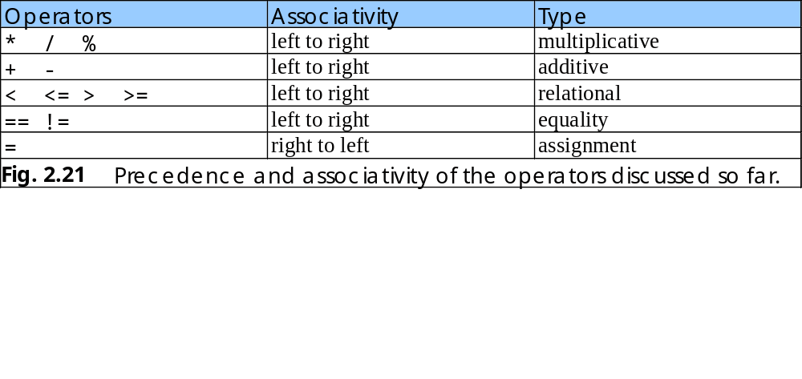
2.8 Decision Making: Equality and Relational Operators
Precedence of operators
  All operators except for = (assignment) associates from left to right
    For example: x = y = z is evaluated x = (y = z)

Slide 52
Lab Task 1 (BSE16A)
Take two strings from the users via dialog boxes. One is IP address and second is subnet mask. Print the Network and Host portion of IP address based on subnet mask.
    For example Input
    IP address = 192.168.13.0
    Subnet mask = 255.255.255.0
    Output
    Host portion contains 8 bits
    Network portion contains 24 bits
    Explore the string class via JDK documentation.

Slide 53
Lab Task 2 (BSE16A)
Input a string with the help of dialog box (as IP address) from the user and Verify the IP address and printout four portion of IP address

Slide 54
Lab Task 1 (BSE16B)
Take two strings from the users via dialog boxes. Verify whether the input strings are IP addresses or not! Moreover you will also classify the IP address either as Class B or None.
    (Class B : 128-191)
    Explore the string class via JDK documentation.

Slide 55
Lab Task 2 (BSE16B)
Input a string with the help of dialog box from the user and find out the following things against the entered string:
  Number of digits in the string
  Number of characters in the string
  Number of blank lines in the string
  Number of special characters

Slide 56
java.net.*
The java.net package provides the classes for implementing networking applications
The documentation is available in instructor notes and also you can be download from the following link
  http://java.sun.com/j2se/1.6.0/docs/api/
CPS422: Introduction

Slide 57
InetAddress
http://java.sun.com/j2se/1.6.0/docs/api/java/net/InetAddress.html
This class represents an Internet Protocol (IP) address
It converts numeric addresses to host names and host names to numeric addresses.
It is used by other network classes like Socket and ServerSocket to identify hosts
There are no public InetAddress() constructors
CPS422: Introduction

Slide 58
Creating InetAddress objects
Static methods that can be used to create new InetAddress objects
  getByName
  getByAddress
  getAllByName
  getLocalHost
CPS422: Introduction

Slide 59
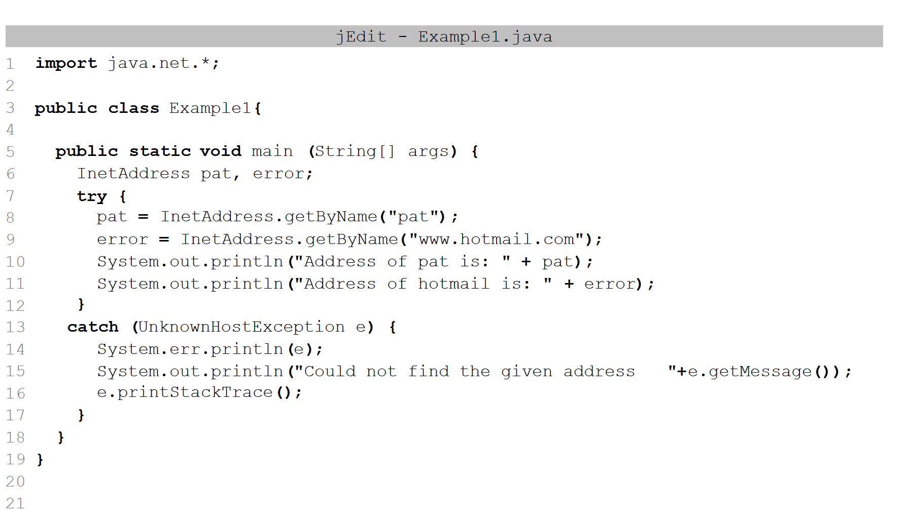
getByName() method
public static InetAddress getByName(String host) throws UnknownHostException
CPS422: Introduction

Slide 60
Some other methods
getLocalHost
  public static InetAddress getLocalHost() throws UnknownHostException
  Returns the local host.
getAddress
public byte[] getAddress()
  Returns the raw IP address of this InetAddress object. The result is in network byte order: the highest order byte of the address is in getAddress()[0]
getHostName
public String getHostName()
  Gets the host name for this IP address
CPS422: Introduction

Slide 61
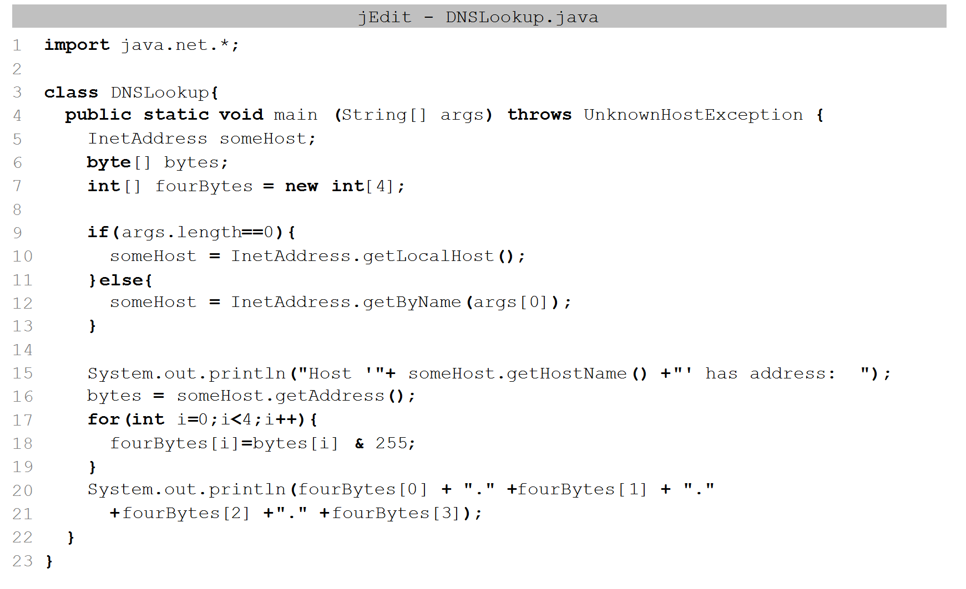
DNSLookup Example
CPS422: Introduction

Slide 62
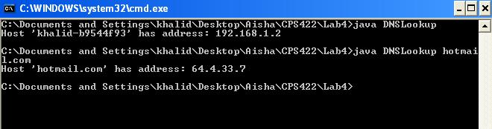
DNSLookup Output
CPS422: Introduction

Slide 63
Task 1
Write a program that prints the addresses and names of the local machine and two well-known Internet web sites.
Use appropriate exception handling as explained in Example1.java
CPS422: Introduction

Slide 64
Task 2
Write a program PrintAll.java that takes as input a hostname (using a Dialog Box) and returns all IP addresses of that hostname.
CPS422: Introduction

Slide 65
Task 3
Write a program Alisases.java that checks whether www.nust.edu.pk and nust.edu.pk have the same IP address or not.
CPS422: Introduction

Slide 66
Task 4
Write a program ReverseLookup.java that takes as input an IP address (using a Dialog Box) and returns the hostname for that IP address.
CPS422: Introduction

Slide 67
Task 4
[Bonus – for extra credit] You will need to use the class NetworkInterface of the java.net package to write this program. Write a program that lists all network interfaces attached to your computer.
CPS422: Introduction

